Slide 1
1 Corinthians 1:1-17

Slide 2
1 Paul, called by the will of God to be an apostle of Christ Jesus, and our brother Sosthenes,
² To the church of God that is in Corinth, to those sanctified in Christ Jesus, called to be saints together with all those who in every place call upon the name of our Lord Jesus Christ, both their Lord and ours:
³ Grace to you and peace from God our Father and the Lord Jesus Christ.

Slide 3
⁴ I give thanks to my God always for you because of the grace of God that was given you in Christ Jesus, ⁵ that in every way you were enriched in him in all speech and all knowledge— ⁶ even as the testimony about Christ was confirmed among you— ⁷ so that you are not lacking in any gift, as you wait for the revealing of our Lord Jesus Christ, ⁸ who will sustain you to the end, guiltless in the day of our Lord Jesus Christ. ⁹ God is faithful, by whom you were called into the fellowship of his Son, Jesus Christ our Lord.

Slide 4
¹⁰ I appeal to you, brothers, by the name of our Lord Jesus Christ, that all of you agree, and that there be no divisions among you, but that you be united in the same mind and the same judgment. ¹¹ For it has been reported to me by Chloe’s people that there is quarreling among you, my brothers. ¹² What I mean is that each one of you says, “I follow Paul,” or “I follow Apollos,” or “I follow Cephas,” or “I follow Christ.” ¹³ Is Christ divided? Was Paul crucified for you? Or were you baptized in the name of Paul?

Slide 5
¹⁴ I thank God that I baptized none of you except Crispus and Gaius, ¹⁵ so that no one may say that you were baptized in my name. ¹⁶ (I did baptize also the household of Stephanas. Beyond that, I do not know whether I baptized anyone else.) ¹⁷ For Christ did not send me to baptize but to preach the gospel, and not with words of eloquent wisdom, lest the cross of Christ be emptied of its power.

Slide 6
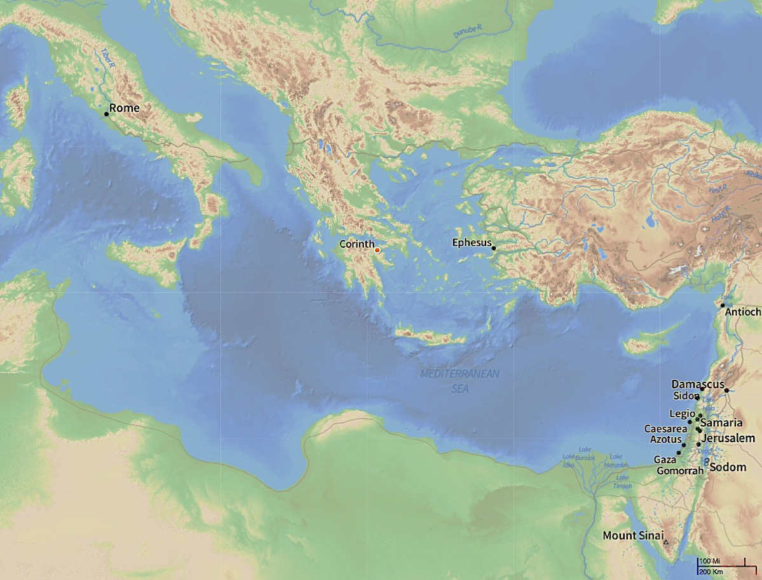
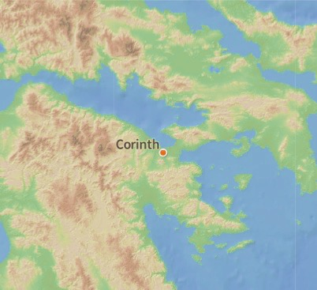

Slide 7
Paul planted the church at Corinth
^{1 Cor 4:15}…. I became your father in Christ Jesus through the gospel.
A pastor’s heart – feeling responsible for them; saddened with their fall; hurt that some have turned against him.
1 Corinthians – Written to a church tearing itself apart
A church being torn apart by pride / politics / self righteousness / failure to love
¹⁰ I appeal to you, brothers, by the name of our Lord Jesus Christ, that all of you agree, and that there be no divisions among you, but that you be united in the same mind and the same judgment.
A church greatly gifted – knowledge; Speakers; Spiritual gifts
But lacking love and unity ( Pride ) ( Knowledge puffs up. Love builds up )
No room for pride – We are all on an equal footing with Christ Jesus
Called to be saints together. With everyone who calls on the name of the Lord
Spiritual gifts do not indicate spiritual superiority
Knowledge & eloquence of speech are not the power of the Gospel
We all await Jesus’ return, as He sustains us and our guiltlessness
⁹ God is faithful, by whom you were called into the fellowship of his Son

Slide 8
1 Corinthians – A church being torn apart by pride / politics / self righteousness / failure to love
A church greatly gifted – knowledge; Speakers; Spiritual gifts
But lacking love and unity ( Pride ) ( Knowledge puffs up. Love builds up )
No room for pride – We are all on an equal footing with Christ Jesus
Called to be saints together. With everyone who calls on the name of the Lord
Spiritual gifts do not indicate spiritual superiority
Knowledge & eloquence of speech are not the power of the Gospel
We all await Jesus’ return, as He sustains us and our guiltlessness
⁹ God is faithful, by whom you were called into the fellowship of his Son
We are called into fellowship with one another in Christ Jesus
Losing an attitude of spiritual superiority....

Slide 9
ESV: ¹⁰ I appeal to you, brothers, by the name of our Lord Jesus Christ, that all of you agree, and that there be no divisions among you, but that you be united in the same mind and the same judgment.
NIV: ...., but that you may be perfectly united in mind and thought.
NRSV: ...., but that you be united in the same mind and the same purpose.

Slide 10
1 Corinthians – A church being torn apart by pride / politics / self righteousness / failure to love
A church greatly gifted – knowledge; Speakers; Spiritual gifts
But lacking love and unity ( Pride ) ( Knowledge puffs up. Love builds up )
No room for pride – We are all on an equal footing with Christ Jesus
Called to be saints together. With everyone who calls on the name of the Lord
Spiritual gifts do not indicate spiritual superiority
Knowledge & eloquence of speech are not the power of the Gospel
We all await Jesus’ return, as He sustains us and our guiltlessness
⁹ God is faithful, by whom you were called into the fellowship of his Son
We are called into fellowship with one another in Christ Jesus
Losing an attitude of spiritual superiority....
“Frame of mind” & “Opinion” from a place of superiority, tears a fellowship apart
“Frame of mind” & “Opinion” yielded to Christ in love for the other promotes unity
One is not spiritually superior to the other
I depend on you. And you depend on me. Otherwise it’s not the fellowship of Christ

